Slide 1
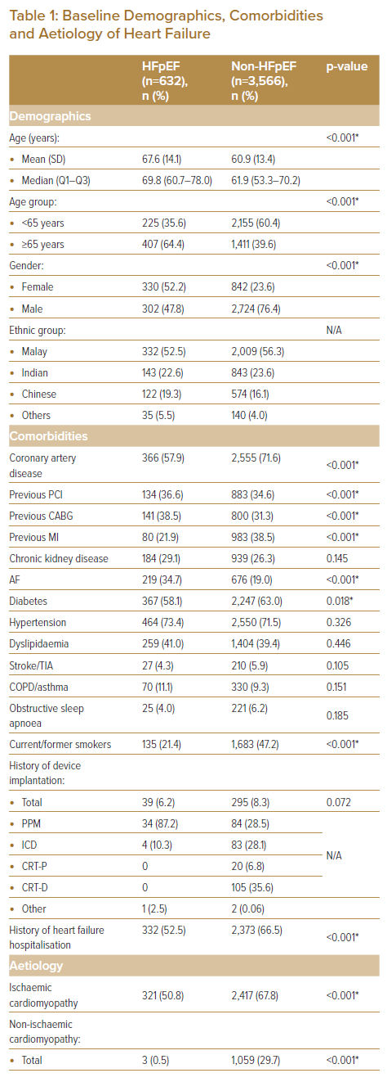
Shariff RER, Koh HB, Sulong MA, Quah WJ, Ong SH, Sabian IS, Jaafar J, Devi ST, Chan JAW, Rahim AAA, Teoh CK, Mohd Ghazi A
Baseline Demographics, Comorbidities and Aetiology of Heart Failure
Citation: Journal of Asian Pacific Society of Cardiology 2023;2:e07.
https://doi.org/10.15420/japsc.2022.46

