Slide 1
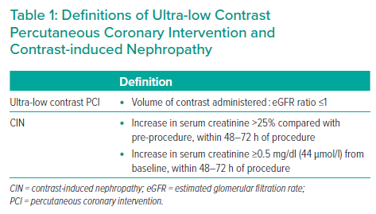
Hennessey B, Shabbir A, Travieso A, Gonzalo N, Escaned J
Definitions of Ultra-low Contrast Percutaneous Coronary Intervention and Contrast-induced Nephropathy
Citation: Interventional Cardiology 2023;18:e09.
https://doi.org/10.15420/icr.2022.32

