Slide 1

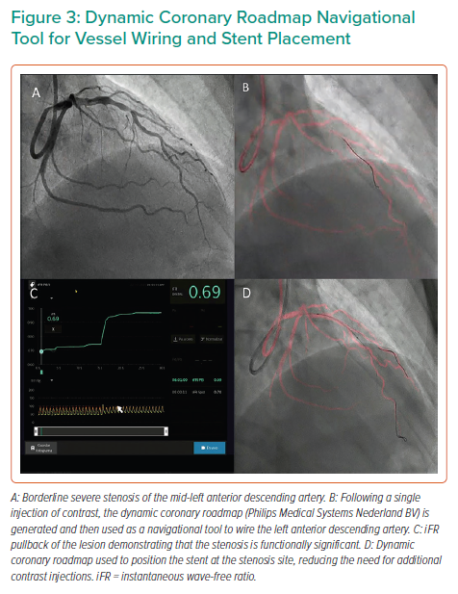
Hennessey B, Shabbir A, Travieso A, Gonzalo N, Escaned J
Dynamic Coronary Roadmap Navigational Tool for Vessel Wiring and Stent Placement
Citation: Interventional Cardiology 2023;18:e09.
https://doi.org/10.15420/icr.2022.32

