Slide 1
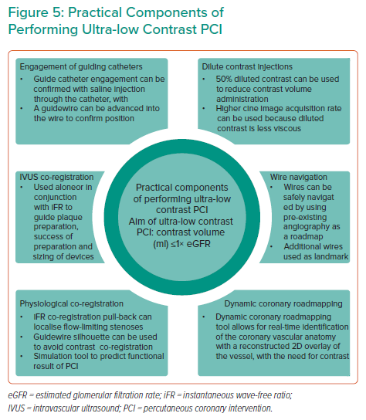
Hennessey B, Shabbir A, Travieso A, Gonzalo N, Escaned J
Practical Components of Performing Ultra-low Contrast PCI
Citation: Interventional Cardiology 2023;18:e09.
https://doi.org/10.15420/icr.2022.32

