Slide 1
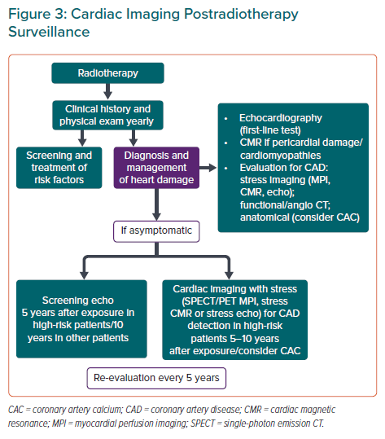
Peix A, Perez A, Barreda AM
Cardiac Imaging Postradiotherapy Surveillance
Citation: European Cardiology Review 2023;18:e08.
https://doi.org/10.15420/ecr.2022.36

