Slide 1
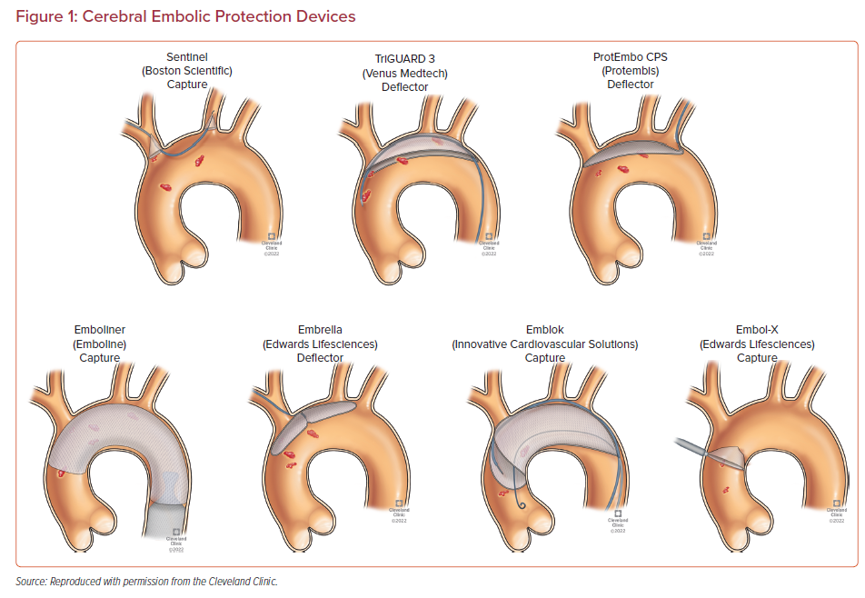
Agrawal A, Isogai T, Shekhar S, Kapadia SR
Cerebral Embolic Protection Devices
Citation: US Cardiology Review 2023;17;e02.
https://doi.org/10.15420/usc.2022.12

