Slide 1
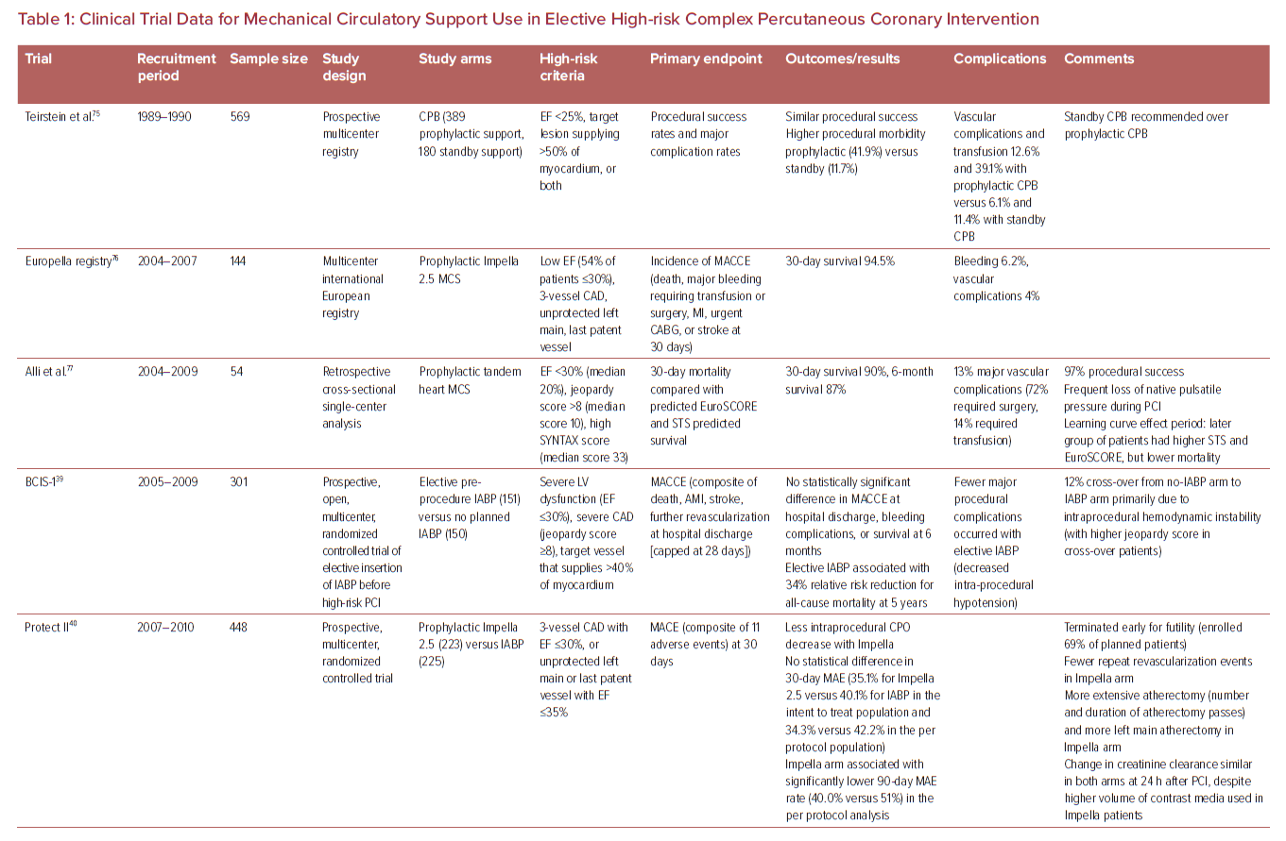
Truesdell AG, Davies RE, Eltelbany M, Megaly M, Rosner C, Cilia LA
Clinical Trial Data for Mechanical Circulatory Support Use in Elective High-risk Complex Percutaneous Coronary Intervention
Citation: US Cardiology Review 2023;17:e03.
https://doi.org/10.15420/usc.2022.26

