Slide 1
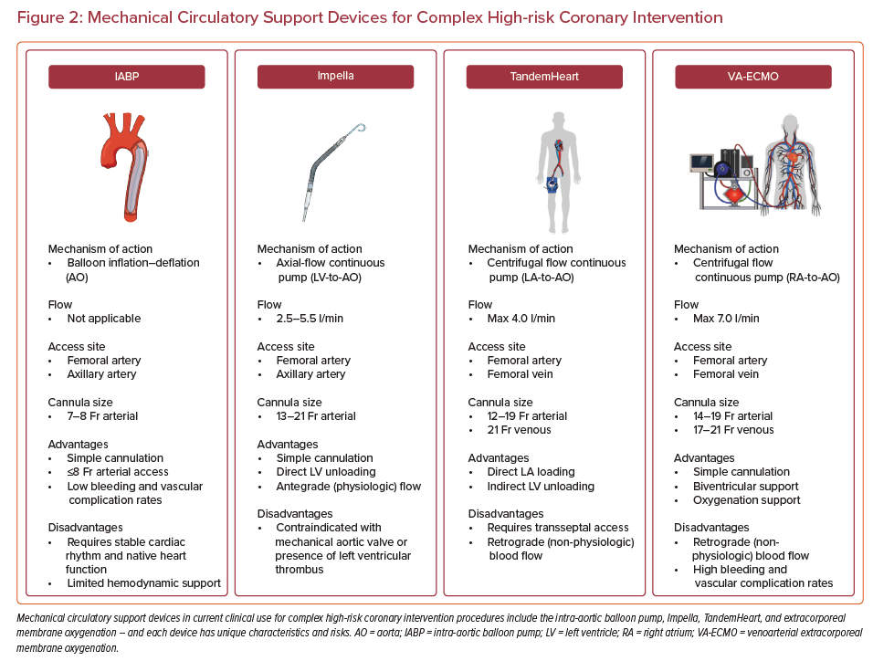
Truesdell AG, Davies RE, Eltelbany M, Megaly M, Rosner C, Cilia LA
Mechanical Circulatory Support Devices for Complex High-risk Coronary Intervention
Citation: US Cardiology Review 2023;17:e03.
https://doi.org/10.15420/usc.2022.26

