Slide 1

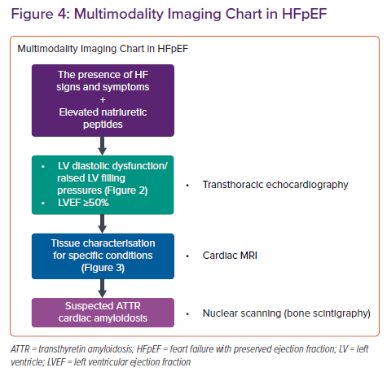
Ünlü S, Özden �, Çelik A
Multimodality Imaging Chart in HFpEF
Citation: Cardiac Failure Review 2023;9:e04.
https://doi.org/10.15420/cfr.2022.27

