Slide 1
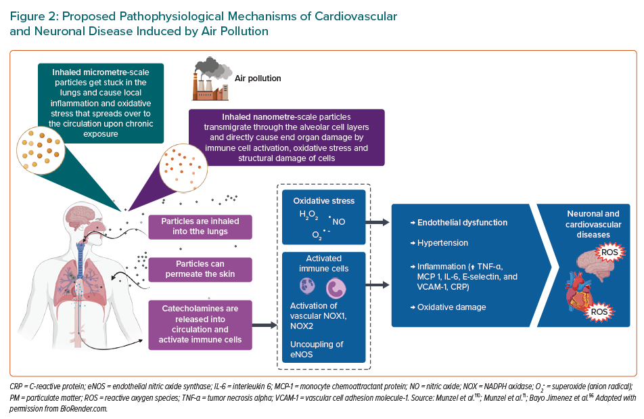
Jimenez MTB, Hahad O, Kuntic M, Daiber A, Münzel T
Proposed Pathophysiological Mechanisms of Cardiovascular and Neuronal Disease Induced by Air Pollution
Citation: European Cardiology Review 2023;18:e09.
https://doi.org/10.15420/ecr.2022.41

