Slide 1

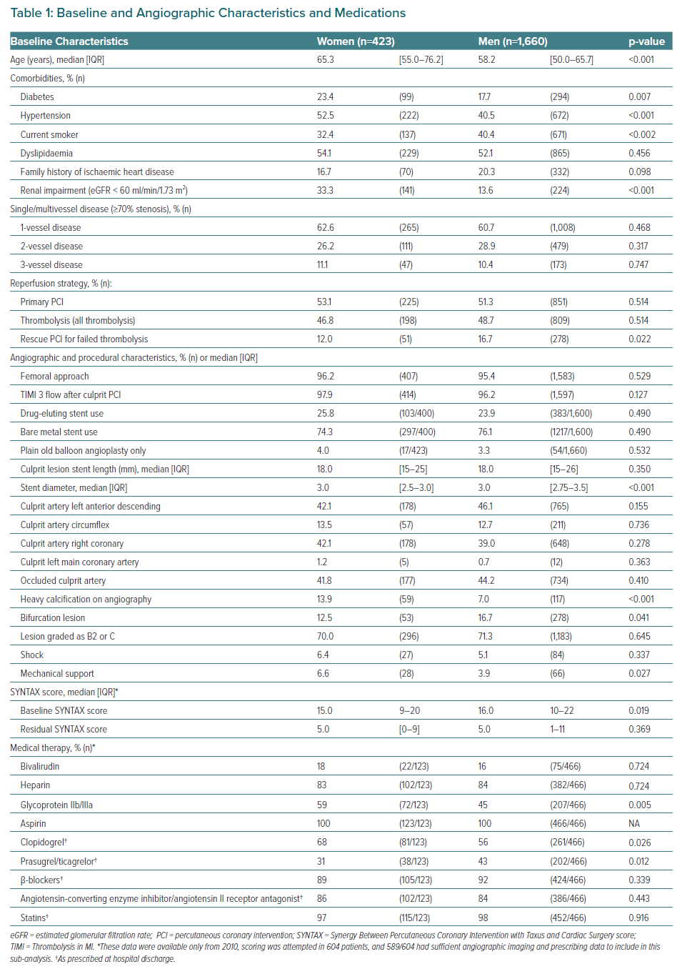
Burgess S, Juergens CP, Yang W, Shugman IM, Idris H, Nguyen T, McLean A, Zaman S, Thomas L, Robledo KP, Mussap C, Lo ST, French J
Baseline and Angiographic Characteristics and Medications
Citation: European Cardiology Review 2023;18:e10.
https://doi.org/10.15420/ecr.2022.39

