Slide 1
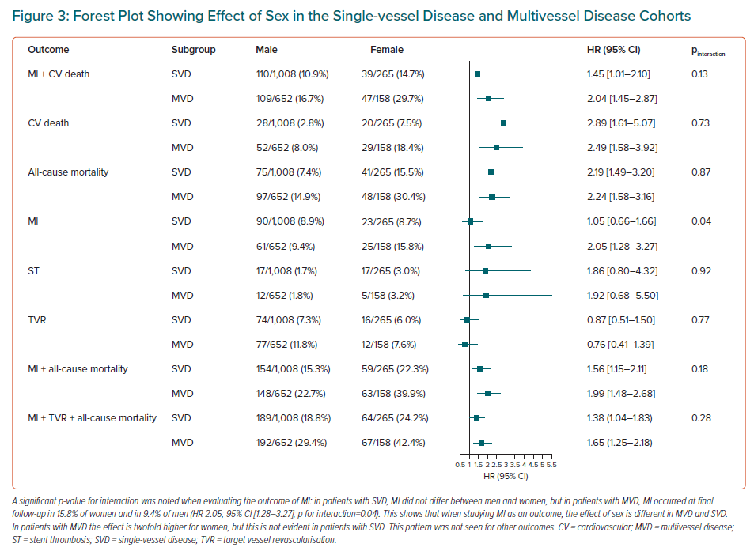
Burgess S, Juergens CP, Yang W, Shugman IM, Idris H, Nguyen T, McLean A, Zaman S, Thomas L, Robledo KP, Mussap C, Lo ST, French J
Forest Plot Showing Effect of Sex in the Single-vessel Disease and Multivessel Disease Cohorts
Citation: European Cardiology Review 2023;18:e10.
https://doi.org/10.15420/ecr.2022.39

