Slide 1

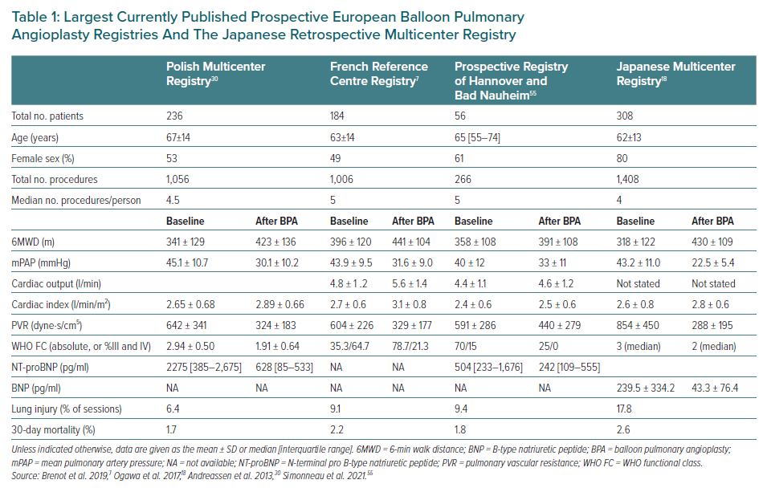
Lang IM
Largest Currently Published Prospective European Balloon Pulmonary Angioplasty Registries And The Japanese Retrospective Multicenter Registry
Citation: European Cardiology Review 2023;18:e11.
https://doi.org/10.15420/ecr.2022.29

