Slide 1
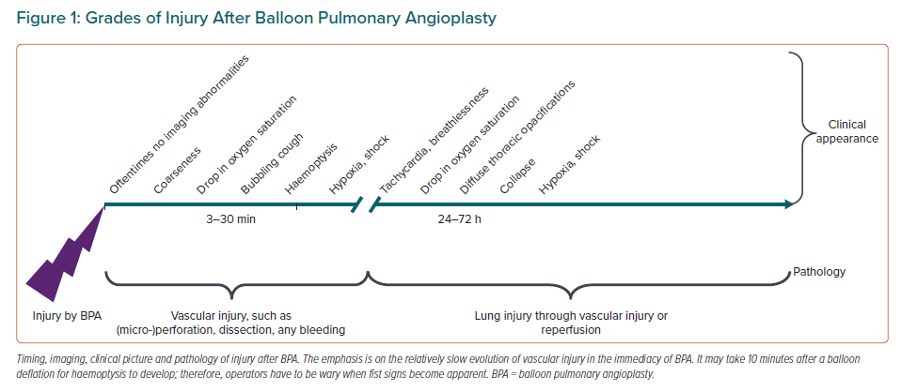
Lang IM
Grades of Injury After Balloon Pulmonary Angioplasty
Citation: European Cardiology Review 2023;18:e11.
https://doi.org/10.15420/ecr.2022.29

