Slide 1
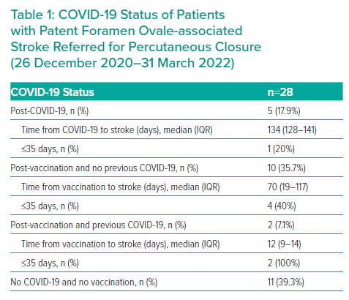
Rojko M, Suligoj NC, Zorc M, Noc M
COVID-19 Status of Patients with Patent Foramen Ovale-associated Stroke Referred for Percutaneous Closure (26 December 2020–31 March 2022)
Citation: Interventional Cardiology 2023;18:e10.
https://doi.org/10.15420/icr.2022.27

