Slide 1
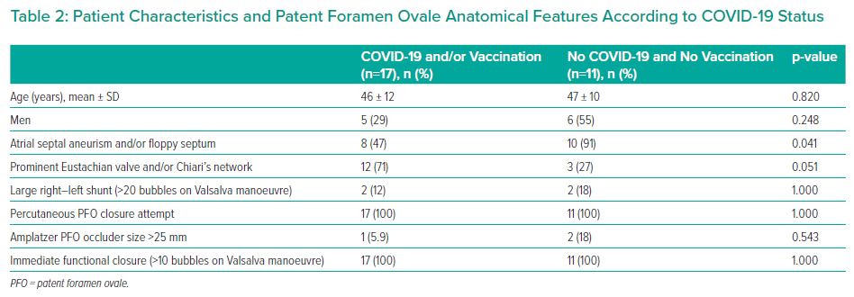
Rojko M, Suligoj NC, Zorc M, Noc M
Patient Characteristics and Patent Foramen Ovale Anatomical Features According to COVID-19 Status
Citation: Interventional Cardiology 2023;18:e10.
https://doi.org/10.15420/icr.2022.27

