Slide 1
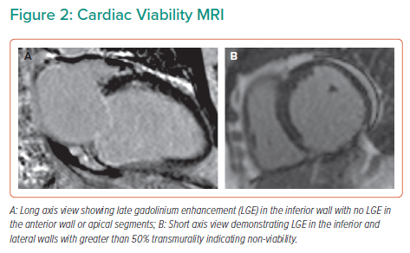
Ezad SM, Babu G, O’Kane P
Cardiac Viability MRI
Citation: Interventional Cardiology 2023;18:e11.
https://doi.org/10.15420/icr.2022.14

