Slide 1
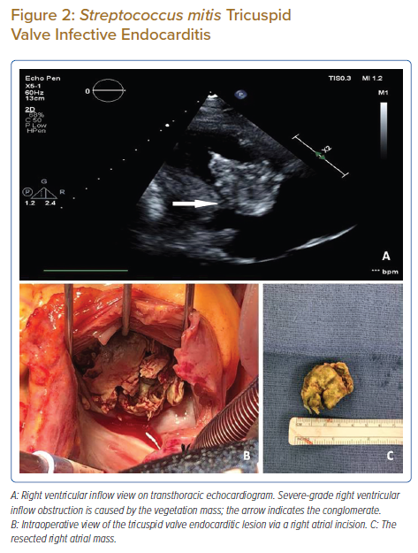
Göbölös L, Manla Y, Hogan M, Bhatnagar G, Aleinati T
Streptococcus mitis Tricuspid Valve Infective Endocarditis
Citation: Journal of Asian Pacific Society of Cardiology 2023;2:e08.
https://doi.org/10.15420/japsc.2022.18

