Slide 1
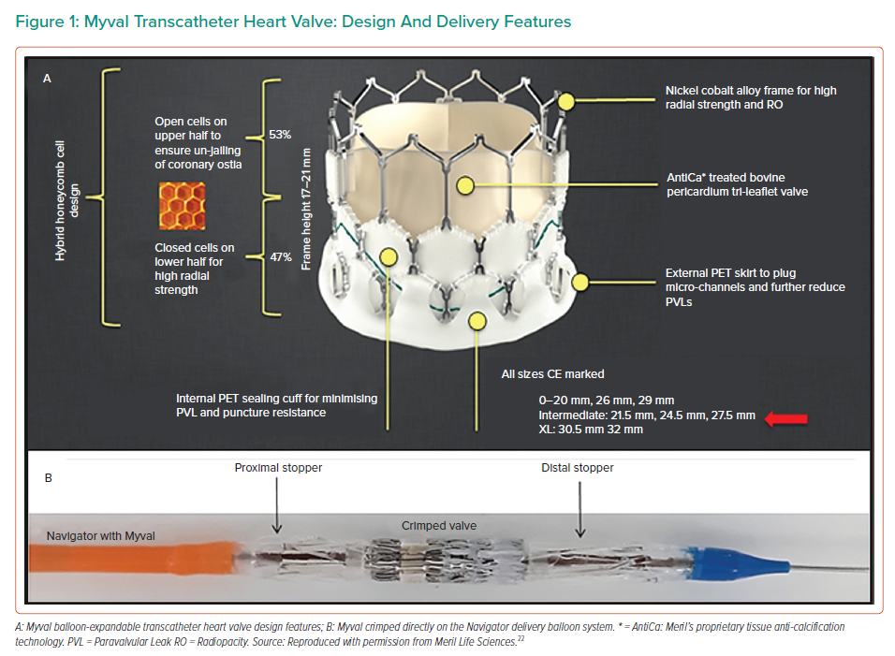
Seth A, Kumar V, Singh VP, Kumar D, Varma P, Rastogi V
Myval Transcatheter Heart Valve: Design And Delivery Features
Citation: Interventional Cardiology 2023;18:e12.
https://doi.org/10.15420/icr.2020.32

