Slide 1
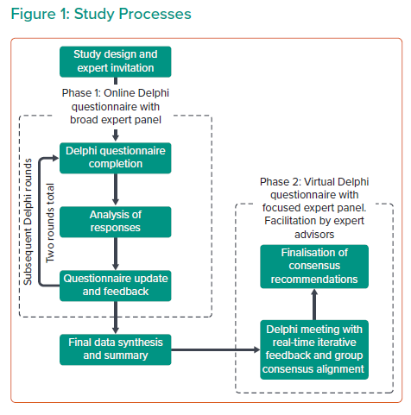
Zaman A, Prendergast B, Hildick-Smith D, Blackman DJ, Anderson R, Spence M, Mylotte D, Smith D, Wilding B, Chapman C, Atkins K, Pollock KG, Qureshi AC, Banning AP
Study Processes
Citation: Interventional Cardiology 2023;18:e13.
https://doi.org/10.15420/icr.2022.11

