Slide 1
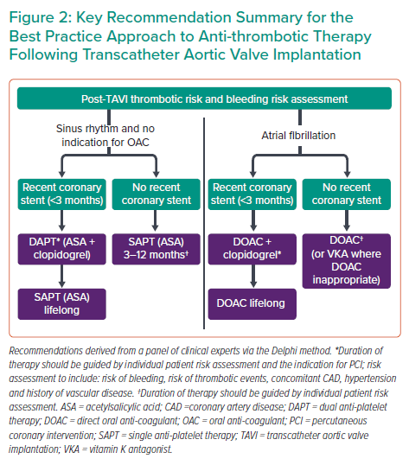
Zaman A, Prendergast B, Hildick-Smith D, Blackman DJ, Anderson R, Spence M, Mylotte D, Smith D, Wilding B, Chapman C, Atkins K, Pollock KG, Qureshi AC, Banning AP
Key Recommendation Summary for the Best Practice Approach to Anti-thrombotic Therapy Following Transcatheter Aortic Valve Implantation
Citation: Interventional Cardiology 2023;18:e13.
https://doi.org/10.15420/icr.2022.11

