Slide 1
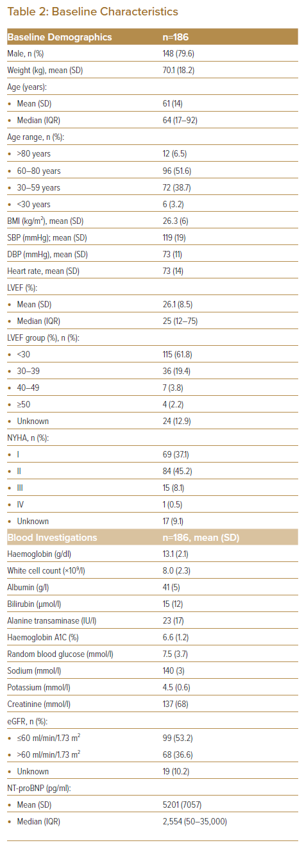
Shariff RER, Koh HB, Sabian IS, Quah WJ, Ong SH, Sulong MA, Jaafar J, Devi ST, Chan JAW, Rahim AAA, Teoh CK, Mohd Ghazi A
Baseline Characteristics
Citation: Journal of Asian Pacific Society of Cardiology 2023;2:e09.
https://doi.org/10.15420/japsc.2022.38

