Slide 1
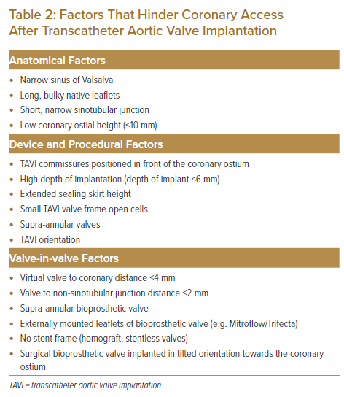
Yap JJL, Ho KW
Factors That Hinder Coronary Access After Transcatheter Aortic Valve Implantation
Citation: Journal of Asian Pacific Society of Cardiology 2023;2:e11.
https://doi.org/10.15420/japsc.2022.28

