Slide 1
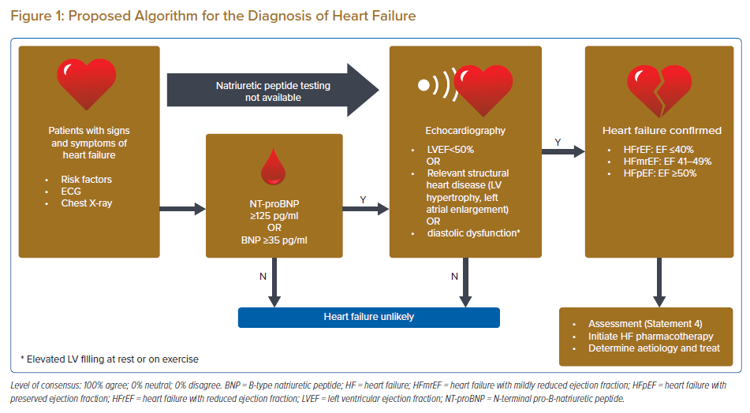
Sim D, Lin W, Sindone A, Yingchoncharoen T, Prameswari HS, Mohd Ghazi A, Pin LC, Teo L, Aw TC, Agbayani MJ, Zhang Y, Li X, Jayagopal P, Matsue Y, Kang SM, Li YH, Ka Lam MW, Thai NQ, Tan JW
Proposed Algorithm for the Diagnosis of Heart Failure
Citation: Journal of Asian Pacific Society of Cardiology 2023;2:e10.
https://doi.org/10.15420/japsc.2022.42

