Slide 1
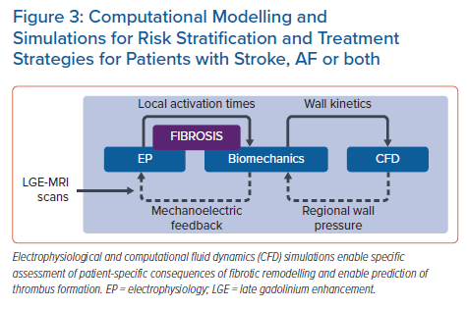
Chahine Y, Magoon MJ, Maidu B, del Álamo JC, Boyle PM, Akoum N
Computational Modelling and Simulations for Risk Stratification and Treatment Strategies for Patients with Stroke, AF or both
Citation: Arrhythmia & Electrophysiology Review 2023;12:e07.
https://doi.org/10.15420/aer.2022.34

