Slide 1

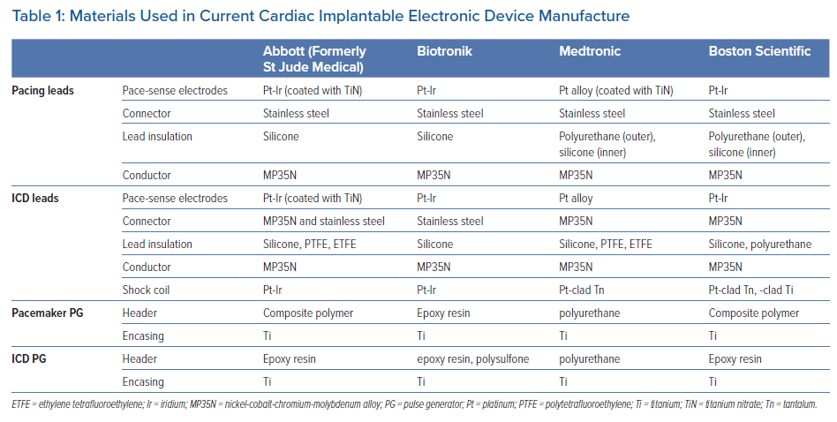
Kealaher E, Shah P, Dissanayake T, Thomas DE, Barry J, Mărgulescu AD
Materials Used in Current Cardiac Implantable Electronic Device Manufacture
Citation: Arrhythmia & Electrophysiology Review 2023;12:e08.
https://doi.org/10.15420/aer.2022.23

