Slide 1
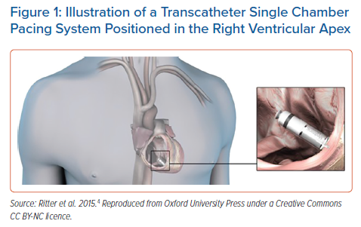
Wijesuriya N, Vere FD, Mehta V, Niederer S, Rinaldi CA, Behar J
Illustration of a Transcatheter Single Chamber Pacing System Positioned in the Right Ventricular Apex
Citation: Arrhythmia & Electrophysiology Review 2023;12:e09.
https://doi.org/10.15420/aer.2022.41

