Slide 1
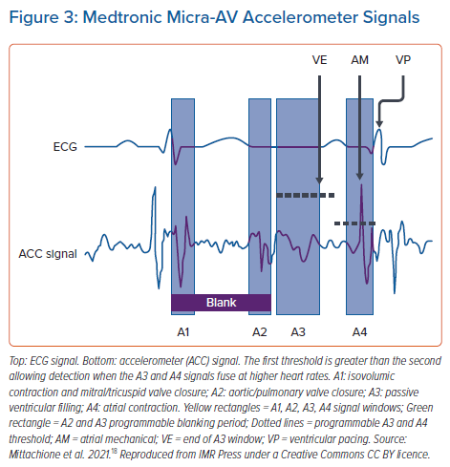
Wijesuriya N, Vere FD, Mehta V, Niederer S, Rinaldi CA, Behar J
Medtronic Micra-AV Accelerometer Signals
Citation: Arrhythmia & Electrophysiology Review 2023;12:e09.
https://doi.org/10.15420/aer.2022.41

