Slide 1
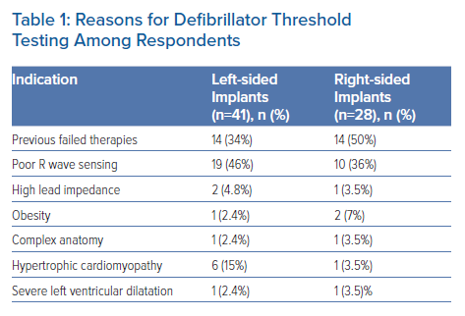
Pope MTB, Paisey J, Roberts PR
Reasons for Defibrillator Threshold Testing Among Respondents
Citation: Arrhythmia & Electrophysiology Review 2023;12:e10.
https://doi.org/10.15420/aer.2022.38

