Slide 1
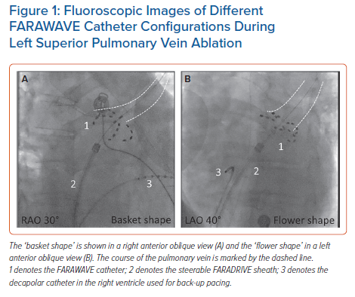
Schaack D, Schmidt B, Tohoku S, Bordignon S, Urbanek L, Ebrahimi R, Hirokami J, Efe TH, Chen S, Chun KJ
Fluoroscopic Images of Different FARAWAVE Catheter Configurations During Left Superior Pulmonary Vein Ablation
Citation: Arrhythmia & Electrophysiology Review 2023;12:e11.
https://doi.org/10.15420/aer.2022.45

