Slide 1
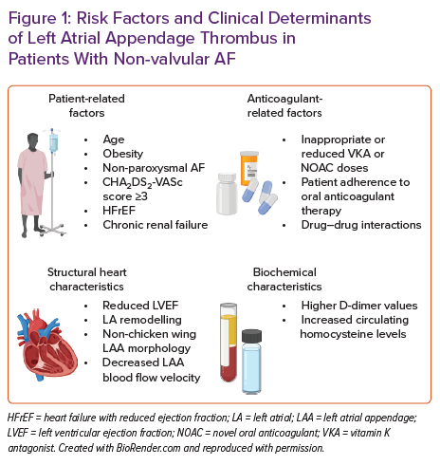
Katic J, Borovac JA
Risk Factors and Clinical Determinants of Left Atrial Appendage Thrombus in Patients With Non-valvular AF
Citation: Cardiac Failure Review 2023;9:e05.
https://doi.org/10.15420/cfr.2022.28

