Slide 1
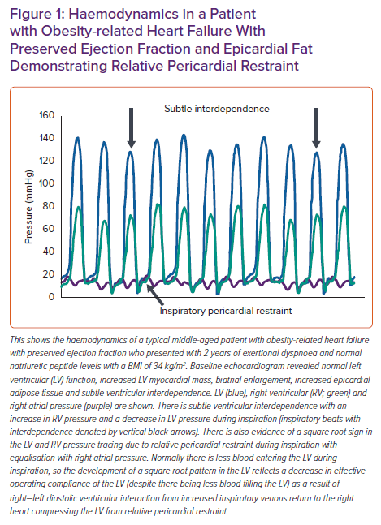
Oduah MT, Sundaram V, Reddy Y
Haemodynamics in a Patient with Obesity-related Heart Failure With Preserved Ejection Fraction and Epicardial Fat Demonstrating Relative Pericardial Restraint
Citation: Cardiac Failure Review 2023;9:e06.
https://doi.org/10.15420/cfr.2022.25

