Slide 1
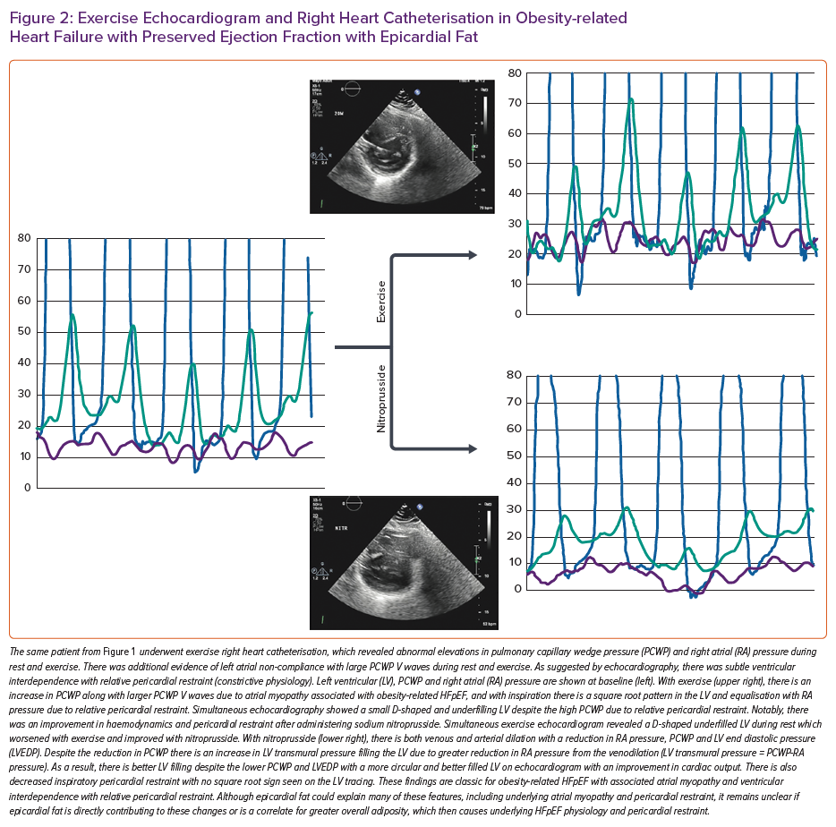
Oduah MT, Sundaram V, Reddy Y
Exercise Echocardiogram and Right Heart Catheterisation in Obesity-related Heart Failure with Preserved Ejection Fraction with Epicardial Fat
Citation: Cardiac Failure Review 2023;9:e06.
https://doi.org/10.15420/cfr.2022.25

