Slide 1
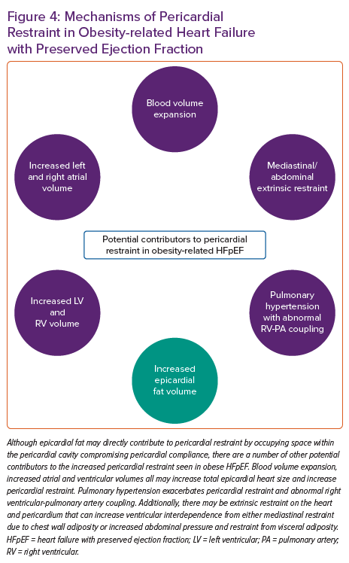
Oduah MT, Sundaram V, Reddy Y
Mechanisms of Pericardial Restraint in Obesity-related Heart Failure with Preserved Ejection Fraction
Citation: Cardiac Failure Review 2023;9:e06.
https://doi.org/10.15420/cfr.2022.25

