Slide 1

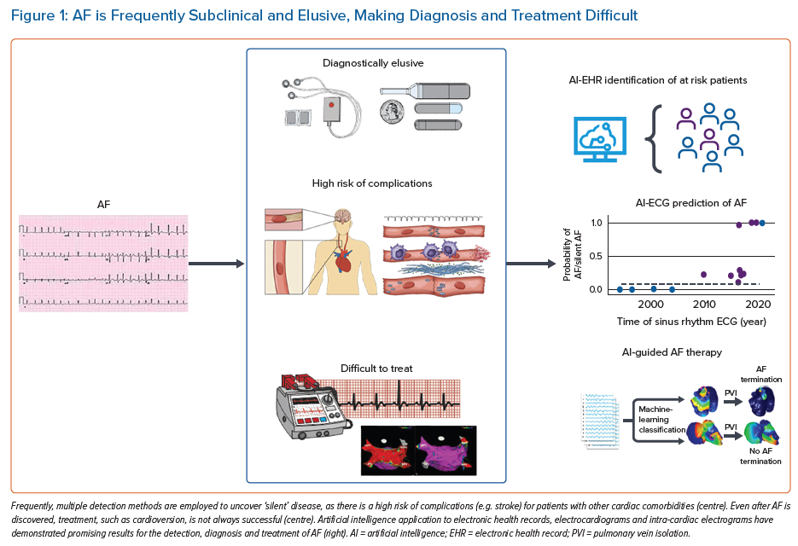
Harmon DM, Sehrawat O, Maanja M, Wight J, Noseworthy P
AF is Frequently Subclinical and Elusive, Making Diagnosis and Treatment Difficult
Citation: Arrhythmia & Electrophysiology Review 2023;12:e12.
https://doi.org/10.15420/aer.2022.31

