Slide 1
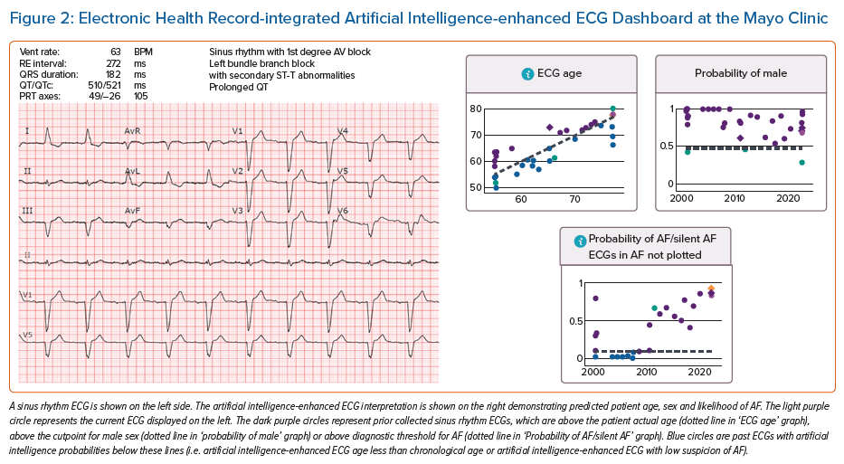
Harmon DM, Sehrawat O, Maanja M, Wight J, Noseworthy P
Electronic Health Record-integrated Artificial Intelligence-enhanced ECG Dashboard at the Mayo Clinic
Citation: Arrhythmia & Electrophysiology Review 2023;12:e12.
https://doi.org/10.15420/aer.2022.31

