Slide 1
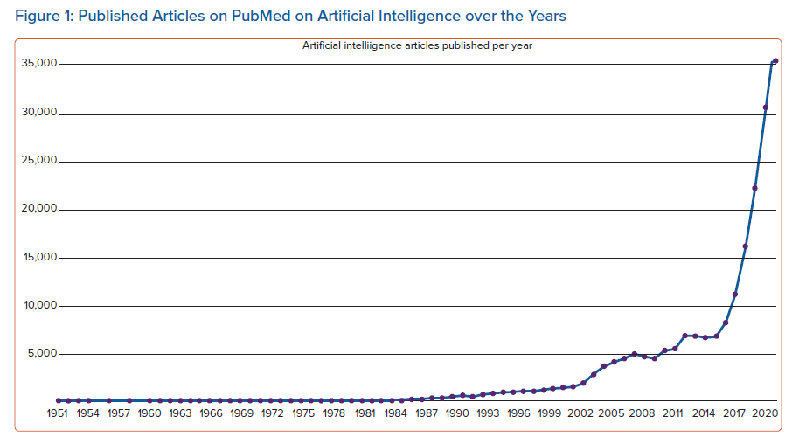
Katritsis DG
Published Articles on PubMed on Artificial Intelligence over the Years
Citation: Arrhythmia & Electrophysiology Review 2023;12:e13.
https://doi.org/10.15420/aer.2023.01

