Slide 1
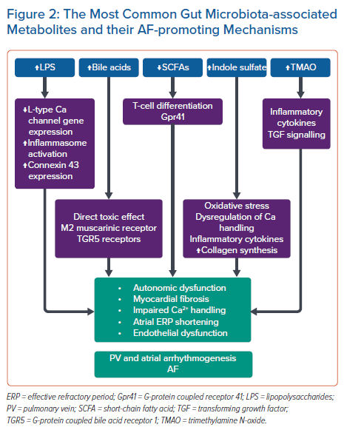
Al-Kaisey AM, Figgett W, Hawson J, Mackay F, Joseph SA, Kalman JM
The Most Common Gut Microbiota-associated Metabolites and their AF-promoting Mechanisms
Citation: Arrhythmia & Electrophysiology Review 2023;12:e14.
https://doi.org/10.15420/aer.2022.33

