Slide 1
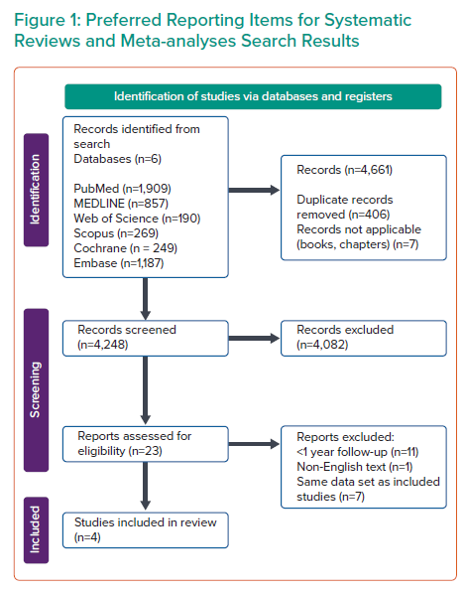
Murphy G, Naughton A, Durand R, Heron E, McCaughey C, Murphy RT, Pearson I
Preferred Reporting Items for Systematic Reviews and Meta-analyses Search Results
Citation: Interventional Cardiology 2023;18:e14.
https://doi.org/10.15420/icr.2022.26

