Slide 1
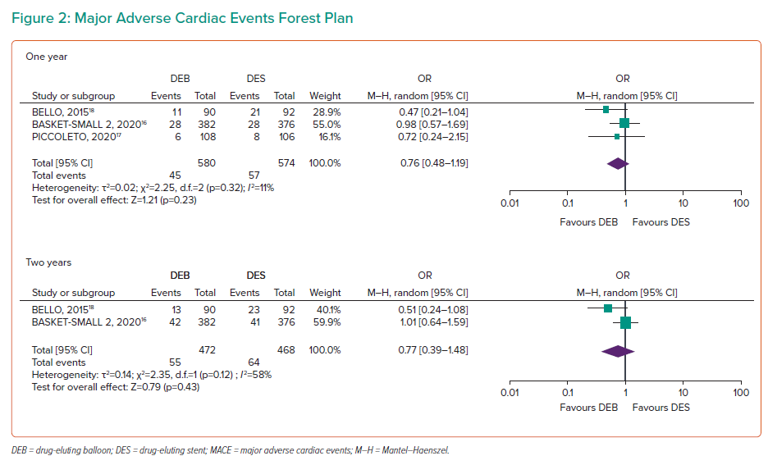
Murphy G, Naughton A, Durand R, Heron E, McCaughey C, Murphy RT, Pearson I
Major Adverse Cardiac Events Forest Plan
Citation: Interventional Cardiology 2023;18:e14.
https://doi.org/10.15420/icr.2022.26

