Slide 1
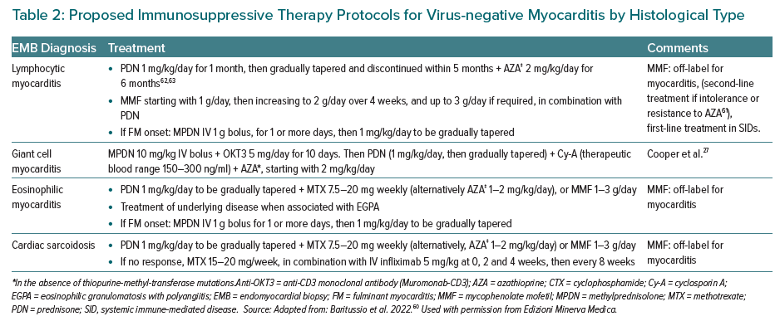
Giordani AS, Baritussio A, Vicenzetto C, Peloso-Cattini MG, Pontara E, Bison E, Fraccaro C, Basso C, Iliceto S, Marcolongo R, Caforio ALP
Proposed Immunosuppressive Therapy Protocols for Virus-negative Myocarditis by Histological Type
Citation: European Cardiology Review 2023;18:e15.
https://doi.org/10.15420/ecr.2022.54

