Slide 1
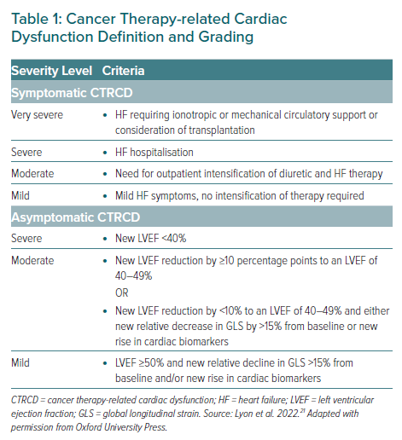
Gent DG, Dobson R
Cancer Therapy-related Cardiac Dysfunction Definition and Grading
Citation: European Cardiology Review 2023;18:e16.
https://doi.org/10.15420/ecr.2022.63

