Slide 1
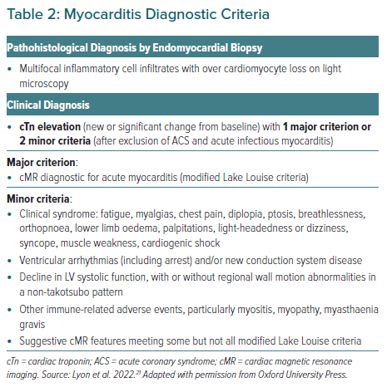
Gent DG, Dobson R
Myocarditis Diagnostic Criteria
Citation: European Cardiology Review 2023;18:e16.
https://doi.org/10.15420/ecr.2022.63

