Slide 1
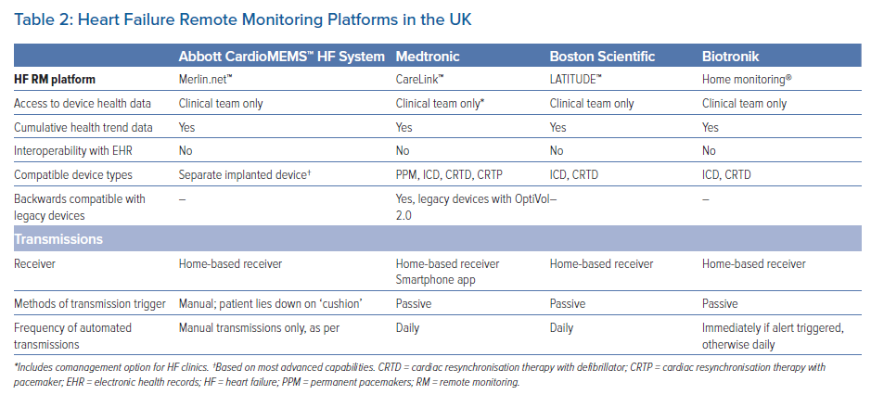
Taylor JK, Ahmed F
Heart Failure Remote Monitoring Platforms in the UK
Citation: Arrhythmia & Electrophysiology Review 2023;12:e15.
https://doi.org/10.15420/aer.2022.13

