Slide 1
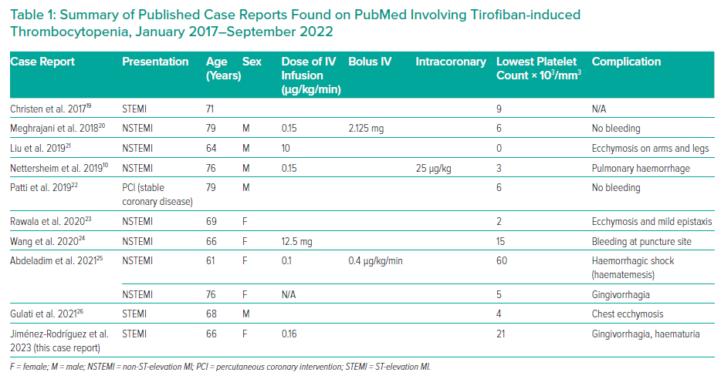
Jimenez-Rodriguez GM, Carmona-Levario P, Ayón-Martínez JA, Gasecka A, Juárez-Orozco LE, Reyes-Ortega A, Espinosa-González P, Altamirano-Solorzano GA, Eid-Lidt G
Summary of Published Case Reports Found on PubMed Involving Tirofiban-induced Thrombocytopenia, January 2017–September 2022
Citation: Interventional Cardiology 2023;17:e15.
https://doi.org/10.15420/icr.2022.23

