Slide 1
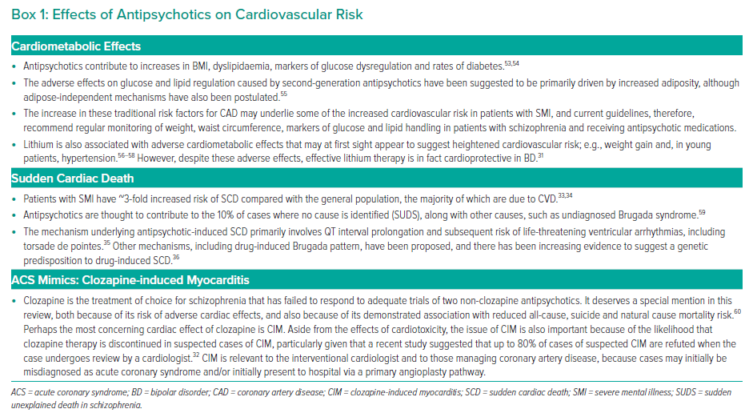
To BT, Roy R, Melikian N, Gaughran FP, O’Gallagher K
Effects of Antipsychotics on Cardiovascular Risk
Citation: Interventional Cardiology 2023;18:e16.
https://doi.org/10.15420/icr.2022.31

