Slide 1
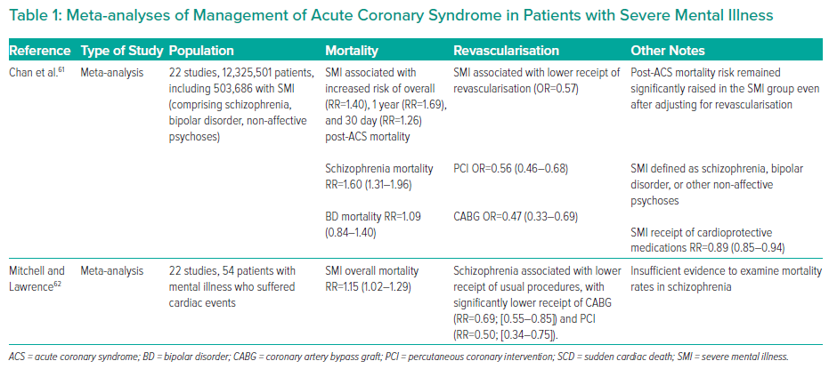
To BT, Roy R, Melikian N, Gaughran FP, O’Gallagher K
Meta-analyses of Management of Acute Coronary Syndrome in Patients with Severe Mental Illness
Citation: Interventional Cardiology 2023;18:e16.
https://doi.org/10.15420/icr.2022.31

