Slide 1
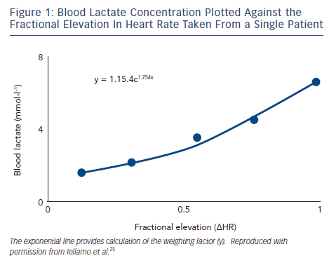
Volterrani M, Iellamo F
Blood Lactate Concentration Plotted Against the Fractional Elevation In Heart Rate Taken From a Single Patient
Citation: Cardiac Failure Review 2016;2(1):63–8
https://doi.org/10.15420/cfr.2015:26:1

