Slide 1
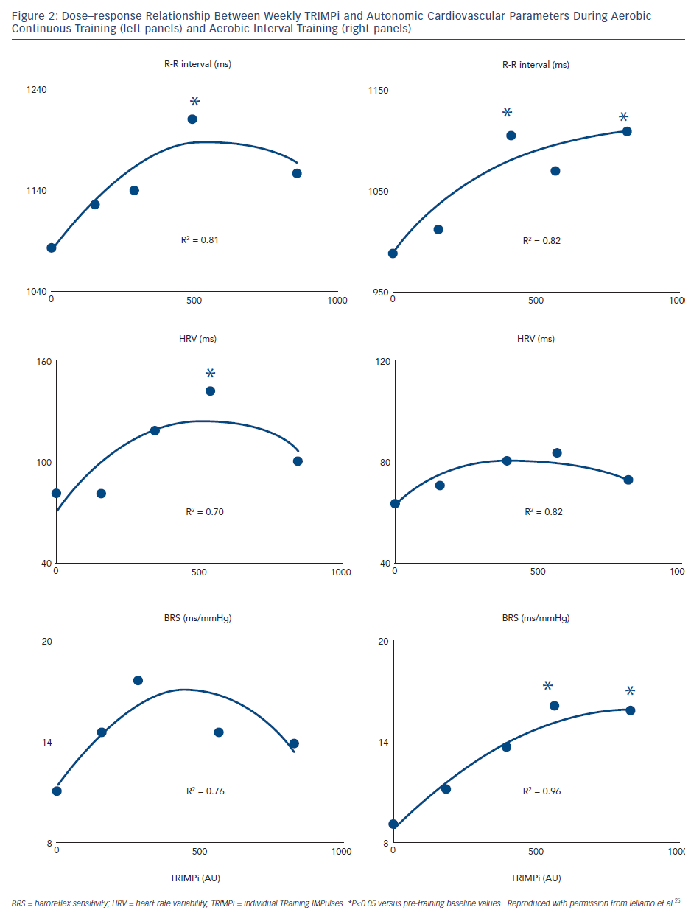
Volterrani M, Iellamo F
Dose–response Relationship Between Weekly TRIMPi and Autonomic Cardiovascular Parameters During Aerobic Continuous Training (left panels) and Aerobic Interval Training (right panels)
Citation: Cardiac Failure Review 2016;2(1):63–8
https://doi.org/10.15420/cfr.2015:26:1

