Slide 1
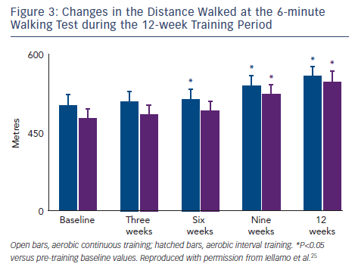
Volterrani M, Iellamo F
Changes in the Distance Walked at the 6-minute Walking Test during the 12-week Training Period
Citation: Cardiac Failure Review 2016;2(1):63–8
https://doi.org/10.15420/cfr.2015:26:1

